Slide 1
Assignment 5
Group 1: Adrien Thébault, Vincent Taneli Olander, Nafisa Raihana

Slide 2
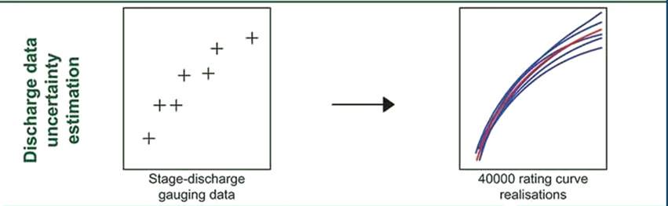
Preconsiderations
Motivation
Discharge is seldom measured directly
→ Calculated value can differ from the real one
Sources of error
Error in measurement
Low and high discharge events are rare
→ Unreliable/insufficient data at the extremes
Real rating curve is not stationary
etc. etc. …
Result
There are many possible rating curves, none of which will ever be perfect
→ What is the impact of this uncertainty?
Rating curve uncertainty. From Hydrological model calibration with uncertain discharge data, by Westerberg et al., 2020

Slide 3
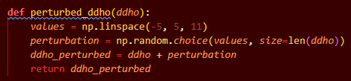
Fitting the Curve
Discrete Perturbation
Database consisting of depth-discharge-pairs
Idea
Perturb the depth in integers
Find the corresponding discharge value
Difficulties
Values not found in the original data can be formed
→ Extrapolation at the limits /
Interpolation in between
Perturbation
Pairs
Assigned values
ddho_ref | ddho__per
… | …
272.750 | 275.750
… | …
213.000 | 214.000
… | …
307.250 | 309.250
… | …
439.000 | 438.000
… | …
472.750 | 475.750
diso__ref | ddho__ref
… | …
8.450 | 214.000
… | …
18.150 | 275.750
… | …
22.925 | 309.250
… | …
62.300 | 438.000
57.700 | 438.000
… | …
151.250 | 472.750
diso__ref | ddho__per
… | …
18.150 | 275.750
… | …
8.450 | 214.000
… | …
22.925 | 309.250
… | …
60000 | 438.000
… | …
Error 404

Slide 4
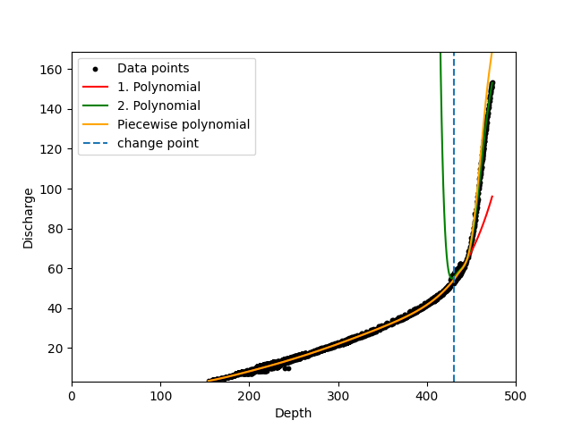
Fitting the Curve
Piecewise Polynomial
A smooth polynomial calculated with two polynomials
Idea
Data has a change point
Fit one polynomial to the data on each side of the change point
Create a third polynomial with a smooth transition at the change point
Difficulties
Identifying the change point
Smooth transition at the change point
The third Polynomial should always be convex

Slide 5
Fitting the Curve
Linear Regression in Logspace
Applying a linear regression in logspace
Idea
Put the data into a logspace
Select change point(s)
Apply piecewise linear regressions
Difficulties
Identifying the change point(s)
Smooth transition at the change point(s)

Slide 6
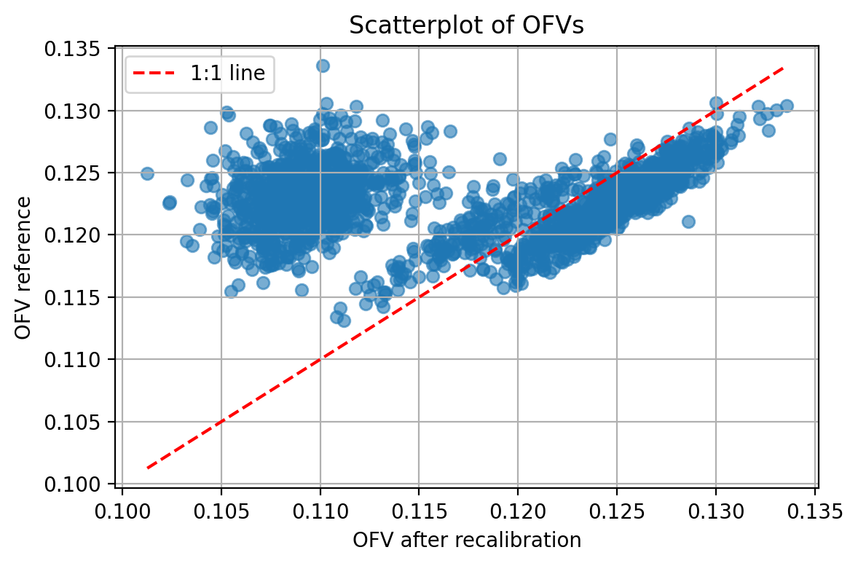
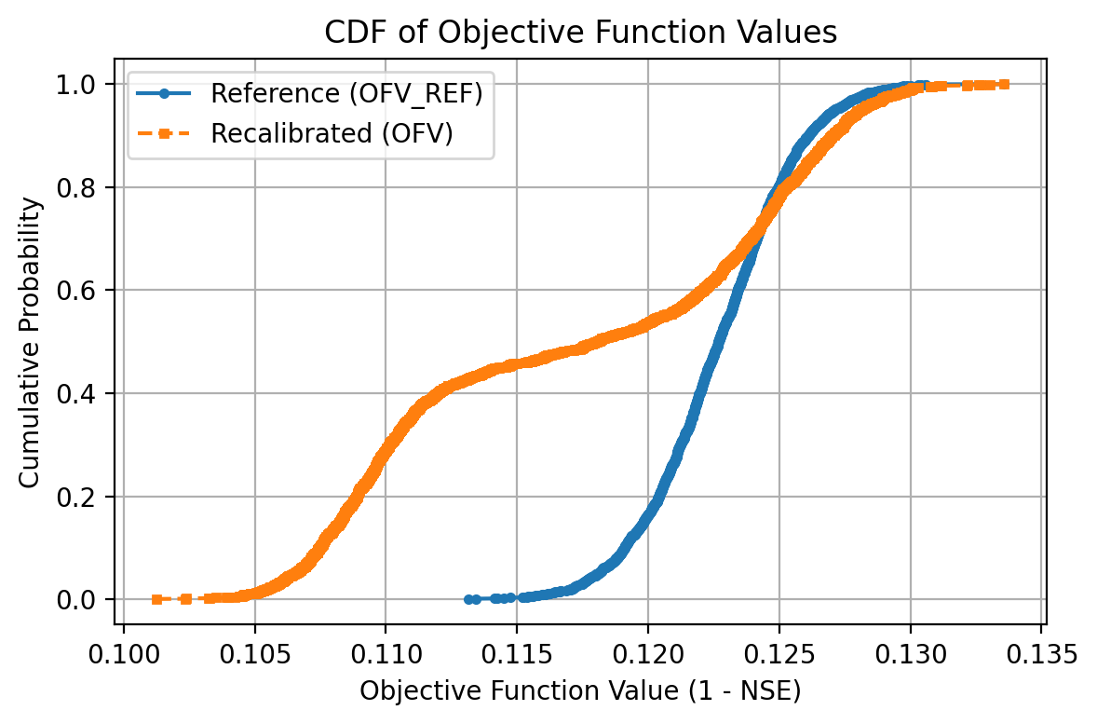
Results
Objective Function Value
Best OFV from Assignment 1: 0.092 ↔ Mean OFV = 0.126

Slide 7
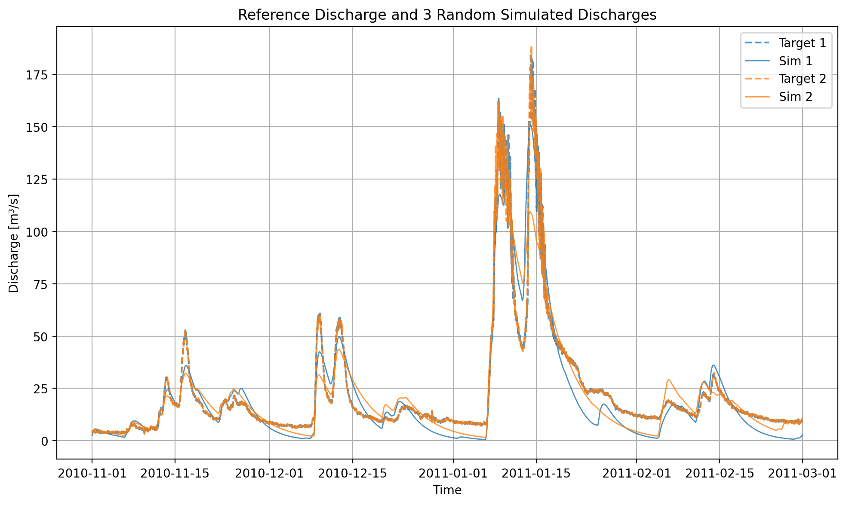
Results
Random Simulations
2
Small changes in depth lead to notable differences in discharge
Peaks are the susceptible to change

Slide 8
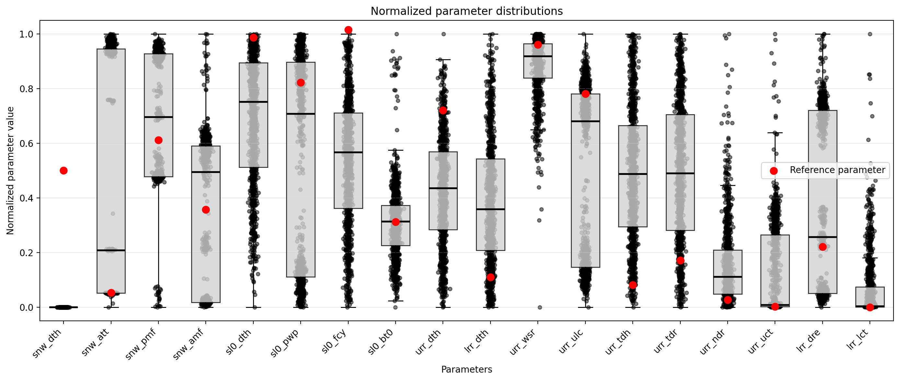
Results
Paramteres

Slide 9
Results
Discussion
What is the effect of uncertain discharge?
A relatively small perturbation in depth ( 5/250 = 2 %) leads to relatively higher differences in the OFV 0.370
 | Start | Δ | %
Depth | 250 | 5 | 2
OFV | 0.092 | 0.034 | 37

